Slide 1
PYTHON – DATA TYPES - STRING

Slide 2
String Data Type
>>> str1 = "Hello"
>>> str2 = 'there'
>>> bob = str1 + str2
>>> print(bob)
Hellothere
>>> str3 = '123'
>>> str3 = str3 + 1
Traceback (most recent call last): File "<stdin>", line 1, in <module>
TypeError: cannot concatenate 'str' and 'int' objects
>>> x = int(str3) + 1
>>> print(x)
124
>>>
A string is a sequence of characters
A string literal uses quotes
'Hello' or "Hello"
For strings, + means “concatenate”
When a string contains numbers, it is still a string
We can convert numbers in a string into a number using int()

Slide 3
Reading and Converting
>>> name = input('Enter:')
Enter:Chuck
>>> print(name)
Chuck
>>> apple = input('Enter:')
Enter:100
>>> x = apple – 10
Traceback (most recent call last): File "<stdin>", line 1, in <module>
TypeError: unsupported operand type(s) for -: 'str' and 'int'
>>> x = int(apple) – 10
>>> print(x)
90
We prefer to read data in using strings and then parse and convert the data as we need
This gives us more control over error situations and/or bad user input
Input numbers must be converted from strings

Slide 4
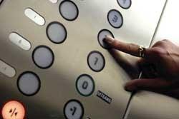
Looking Inside Strings
We can get at any single character in a string using an index specified in square brackets
The index value must be an integer and starts at zero
The index value can be an expression that is computed
b
a
n
a
n
a
0
1
2
3
4
5
>>> fruit = 'banana'
>>> letter = fruit[1]
>>> print(letter)
a
>>> x = 3
>>> w = fruit[x - 1]
>>> print(w)
n

Slide 5
A Character Too Far
You will get a python error if you attempt to index beyond the end of a string
So be careful when constructing index values and slices
>>> zot = 'abc'
>>> print(zot[5])
Traceback (most recent call last): File "<stdin>", line 1, in <module>
IndexError: string index out of range
>>>

Slide 6
Strings Have Length
The built-in function len gives us the length of a string
b
a
n
a
n
a
0
1
2
3
4
5
>>> fruit = 'banana'
>>> print(len(fruit))
6

Slide 7
len Function
>>> fruit = 'banana'
>>> x = len(fruit)
>>> print(x)
6
A function is some stored code that we use. A function takes some input and produces an output.
len()
function
'banana'
(a string)
6
(a number)

Slide 8
len Function
>>> fruit = 'banana'
>>> x = len(fruit)
>>> print(x)
6
A function is some stored code that we use. A function takes some input and produces an output.
def len(inp):
blah
blah
for x in y:
blah
blah
'banana'
(a string)
6
(a number)

Slide 9
Looping Through Strings
Using a while statement, an iteration variable, and the len function, we can construct a loop to look at each of the letters in a string individually
fruit = 'banana'
index = 0
while index < len(fruit):
letter = fruit[index]
print(index, letter)
index = index + 1
0 b
1 a
2 n
3 a
4 n
5 a

Slide 10
Looping Through Strings
A definite loop using a for statement is much more elegant
The iteration variable is completely taken care of by the for loop
b
a
n
a
n
a
fruit = 'banana'
for letter in fruit:
print(letter)

Slide 11
Looping Through Strings
A definite loop using a for statement is much more elegant
The iteration variable is completely taken care of by the for loop
fruit = 'banana'
for letter in fruit :
print(letter)
b
a
n
a
n
a
index = 0
while index < len(fruit) :
letter = fruit[index]
print(letter)
index = index + 1

Slide 12
Looping and Counting
This is a simple loop that loops through each letter in a string and counts the number of times the loop encounters the 'a' character
word = 'banana'
count = 0
for letter in word :
if letter == 'a' :
count = count + 1
print(count)

Slide 13
Looking Deeper into in
The iteration variable “iterates” through the sequence (ordered set)
The block (body) of code is executed once for each value in the sequence
The iteration variable moves through all of the values in the sequence
Iteration variable
Six-character string
for letter in 'banana' :
print(letter)

Slide 14
Yes
Done?
No
b
a
n
a
n
a
Advance letter
print(letter)
for letter in 'banana' :
print(letter)
The iteration variable “iterates” through the string and the block (body) of code is executed once for each value in the sequence

Slide 15
Slicing Strings
M
o
n
t
y
P
y
t
h
o
n
0
1
2
3
4
5
6
7
8
9
10
11
We can also look at any continuous section of a string using a colon operator
The second number is one beyond the end of the slice - “up to but not including”
If the second number is beyond the end of the string, it stops at the end
>>> s = 'Monty Python'
>>> print(s[0:4])
Mont
>>> print(s[6:7])
P
>>> print(s[6:20])
Python

Slide 16
Slicing Strings
M
o
n
t
y
P
y
t
h
o
n
0
1
2
3
4
5
6
7
8
9
10
11
If we leave off the first number or the last number of the slice, it is assumed to be the beginning or end of the string respectively
>>> s = 'Monty Python'
>>> print(s[:2])
Mo
>>> print(s[8:])
thon
>>> print(s[:])
Monty Python

Slide 17
String Concatenation
When the + operator is applied to strings, it means “concatenation”
>>> a = 'Hello'
>>> b = a + 'There'
>>> print(b)
HelloThere
>>> c = a + ' ' + 'There'
>>> print(c)
Hello There
>>>

Slide 18
Using in as a LOGICAL Operator
>>> fruit = 'banana'
>>> 'n' in fruit
True
>>> 'm' in fruit
False
>>> 'nan' in fruit
True
>>> if 'a' in fruit :
... print('Found it!')
...
Found it!
>>>
The in keyword can also be used to check to see if one string is “in” another string
The in expression is a logical expression that returns True or False and can be used in an if statement

Slide 19
String Comparison
if word == 'banana':
print('All right, bananas.')
if word < 'banana':
print('Your word,' + word + ', comes before banana.')
elif word > 'banana':
print('Your word,' + word + ', comes after banana.')
else:
print('All right, bananas.')

Slide 20
String Library
Python has a number of string functions which are in the string library
These functions are already built into every string - we invoke them by appending the function to the string variable
These functions do not modify the original string, instead they return a new string that has been altered
>>> greet = 'Hello Bob'
>>> zap = greet.lower()
>>> print(zap)
hello bob
>>> print(greet)
Hello Bob
>>> print('Hi There'.lower())
hi there
>>>

Slide 21
>>> stuff = 'Hello world'
>>> type(stuff)
<class 'str'>
>>> dir(stuff)
['capitalize', 'casefold', 'center', 'count', 'encode', 'endswith', 'expandtabs', 'find', 'format', 'format_map', 'index', 'isalnum', 'isalpha', 'isdecimal', 'isdigit', 'isidentifier', 'islower', 'isnumeric', 'isprintable', 'isspace', 'istitle', 'isupper', 'join', 'ljust', 'lower', 'lstrip', 'maketrans', 'partition', 'replace', 'rfind', 'rindex', 'rjust', 'rpartition', 'rsplit', 'rstrip', 'split', 'splitlines', 'startswith', 'strip', 'swapcase', 'title', 'translate', 'upper', 'zfill']
https://docs.python.org/3/library/stdtypes.html#string-methods

Slide 22
String Library
str.capitalize()
str.center(width[, fillchar])
str.endswith(suffix[, start[, end]])
str.find(sub[, start[, end]])
str.lstrip([chars])
str.replace(old, new[, count])
str.lower()
str.rstrip([chars])
str.strip([chars])
str.upper()

Slide 23
Searching a String
b
a
n
a
n
a
We use the find() function to search for a substring within another string
find() finds the first occurrence of the substring
If the substring is not found, find() returns -1
Remember that string position starts at zero
0
1
2
3
4
5
>>> fruit = 'banana'
>>> pos = fruit.find('na')
>>> print(pos)
2
>>> aa = fruit.find('z')
>>> print(aa)
-1

Slide 24
Making everything UPPER CASE
You can make a copy of a string in lower case or upper case
Often when we are searching for a string using find() we first convert the string to lower case so we can search a string regardless of case
>>> greet = 'Hello Bob'
>>> nnn = greet.upper()
>>> print(nnn)
HELLO BOB
>>> www = greet.lower()
>>> print(www)
hello bob
>>>

Slide 25
Search and Replace
The replace() function is like a “search and replace” operation in a word processor
It replaces all occurrences of the search string with the replacement string
>>> greet = 'Hello Bob'
>>> nstr = greet.replace('Bob','Jane')
>>> print(nstr)
Hello Jane
>>> nstr = greet.replace('o','X')
>>> print(nstr)
HellX BXb
>>>

Slide 26
Stripping Whitespace
Sometimes we want to take a string and remove whitespace at the beginning and/or end
lstrip() and rstrip() remove whitespace at the left or right
strip() removes both beginning and ending whitespace
>>> greet = ' Hello Bob '
>>> greet.lstrip()
'Hello Bob '
>>> greet.rstrip()
' Hello Bob'
>>> greet.strip()
'Hello Bob'
>>>

Slide 27
Prefixes
>>> line = 'Please have a nice day'
>>> line.startswith('Please')
True
>>> line.startswith('p')
False

Slide 28

Parsing and Extracting
21
31
From stephen.marquard@uct.ac.za Sat Jan 5 09:14:16 2008
>>> data = 'From stephen.marquard@uct.ac.za Sat Jan 5 09:14:16 2008'
>>> atpos = data.find('@')
>>> print(atpos)
21
>>> sppos = data.find(' ',atpos)
>>> print(sppos)
31
>>> host = data[atpos+1 : sppos]
>>> print(host)
uct.ac.za

Slide 29
TWO KINDS OF STRINGS
Python 2.7.10
>>> x = '이광춘'
>>> type(x)
<type 'str'>
>>> x = u'이광춘'
>>> type(x)
<type 'unicode'>
>>>
Python 3.5.1
>>> x = '이광춘'
>>> type(x)
<class 'str'>
>>> x = u'이광춘'
>>> type(x)
<class 'str'>
>>>
In Python 3, all strings are Unicode

Slide 30
PYTHON – DATA TYPES - LIST

Slide 31
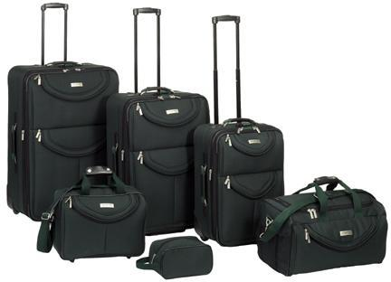
A List is a Kind of Collection
A collection allows us to put many values in a single “variable”
A collection is nice because we can carry all many values around in one convenient package.
friends = [ 'Joseph', 'Glenn', 'Sally' ]
carryon = [ 'socks', 'shirt', 'perfume' ]

Slide 32
List Constants
>>> print([1, 24, 76])
[1, 24, 76]
>>> print(['red', 'yellow', 'blue'])
['red', 'yellow', 'blue']
>>> print(['red', 24, 98.6])
['red', 24, 98.6]
>>> print([ 1, [5, 6], 7])
[1, [5, 6], 7]
>>> print([])
[]
List constants are surrounded by square brackets and the elements in the list are separated by commas
A list element can be any Python object - even another list
A list can be empty

Slide 33
We Already Use Lists!
for i in [5, 4, 3, 2, 1] :
print(i)
print('Blastoff!')
5
4
3
2
1
Blastoff!

Slide 34
Lists and Definite Loops - Best Pals
friends = ['Joseph', 'Glenn', 'Sally']
for friend in friends :
print('Happy New Year:', friend)
print('Done!')
Happy New Year: Joseph
Happy New Year: Glenn
Happy New Year: Sally
Done!
z = ['Joseph', 'Glenn', 'Sally']
for x in z:
print('Happy New Year:', x)
print('Done!')

Slide 35
Looking Inside Lists
Just like strings, we can get at any single element in a list using an index specified in square brackets
>>> friends = [ 'Joseph', 'Glenn', 'Sally' ]
>>> print(friends[1])
Glenn
>>>
Joseph
Glenn
Sally
0
1
2

Slide 36
Lists are Mutable
>>> fruit = 'Banana'
>>> fruit[0] = 'b'
Traceback
TypeError: 'str' object does not
support item assignment
>>> x = fruit.lower()
>>> print(x)
banana
>>> lotto = [2, 14, 26, 41, 63]
>>> print(lotto)
[2, 14, 26, 41, 63]
>>> lotto[2] = 28
>>> print(lotto)
[2, 14, 28, 41, 63]
Strings are “immutable” - we cannot change the contents of a string - we must make a new string to make any change
Lists are “mutable” - we can change an element of a list using the index operator

Slide 37
How Long is a List?
The len() function takes a list as a parameter and returns the number of elements in the list
Actually len() tells us the number of elements of any set or sequence (such as a string...)
>>> greet = 'Hello Bob'
>>> print(len(greet))
9
>>> x = [ 1, 2, 'joe', 99]
>>> print(len(x))
4
>>>

Slide 38
Using the range Function
The range function returns a list of numbers that range from zero to one less than the parameter
We can construct an index loop using for and an integer iterator
>>> print(range(4))
[0, 1, 2, 3]
>>> friends = ['Joseph', 'Glenn', 'Sally']
>>> print(len(friends))
3
>>> print(range(len(friends)))
[0, 1, 2]
>>>

Slide 39
A Tale of Two Loops...
>>> friends = ['Joseph', 'Glenn', 'Sally']
>>> print(len(friends))
3
>>> print(range(len(friends)))
[0, 1, 2]
>>>
friends = ['Joseph', 'Glenn', 'Sally']
for friend in friends :
print('Happy New Year:', friend)
for i in range(len(friends)) :
friend = friends[i]
print('Happy New Year:', friend)
Happy New Year: Joseph
Happy New Year: Glenn
Happy New Year: Sally

Slide 40
Concatenating Lists Using +
>>> a = [1, 2, 3]
>>> b = [4, 5, 6]
>>> c = a + b
>>> print(c)
[1, 2, 3, 4, 5, 6]
>>> print(a)
[1, 2, 3]
We can create a new list by adding two existing lists together

Slide 41
Lists Can Be Sliced Using :
>>> t = [9, 41, 12, 3, 74, 15]
>>> t[1:3]
[41,12]
>>> t[:4]
[9, 41, 12, 3]
>>> t[3:]
[3, 74, 15]
>>> t[:]
[9, 41, 12, 3, 74, 15]
Remember: Just like in strings, the second number is “up to but not including”

Slide 42
List Methods
>>> x = list()
>>> type(x)
<type 'list'>
>>> dir(x)
['append', 'count', 'extend', 'index', 'insert', 'pop', 'remove', 'reverse', 'sort']
>>>
http://docs.python.org/tutorial/datastructures.html

Slide 43
Building a List from Scratch
We can create an empty list and then add elements using the append method
The list stays in order and new elements are added at the end of the list
>>> stuff = list()
>>> stuff.append('book')
>>> stuff.append(99)
>>> print(stuff)
['book', 99]
>>> stuff.append('cookie')
>>> print(stuff)
['book', 99, 'cookie']

Slide 44
Is Something in a List?
Python provides two operators that let you check if an item is in a list
These are logical operators that return True or False
They do not modify the list
>>> some = [1, 9, 21, 10, 16]
>>> 9 in some
True
>>> 15 in some
False
>>> 20 not in some
True
>>>

Slide 45
Lists are in Order
A list can hold many items and keeps those items in the order until we do something to change the order
A list can be sorted
(i.e., change its order)
The sort method (unlike in strings) means “sort yourself”
>>> friends = [ 'Joseph', 'Glenn', 'Sally' ]
>>> friends.sort()
>>> print(friends)
['Glenn', 'Joseph', 'Sally']
>>> print(friends[1])
Joseph
>>>

Slide 46
Built-in Functions and Lists
There are a number of functions built into Python that take lists as parameters
Remember the loops we built? These are much simpler.
>>> nums = [3, 41, 12, 9, 74, 15]
>>> print(len(nums))
6
>>> print(max(nums))
74
>>> print(min(nums))
3
>>> print(sum(nums))
154
>>> print(sum(nums)/len(nums))
25.6

Slide 47
Enter a number: 3
Enter a number: 9
Enter a number: 5
Enter a number: done
Average: 5.66666666667
total = 0
count = 0
while True :
inp = input('Enter a number: ')
if inp == 'done' : break
value = float(inp)
total = total + value
count = count + 1
average = total / count
print('Average:', average)
numlist = list()
while True :
inp = input('Enter a number: ')
if inp == 'done' : break
value = float(inp)
numlist.append(value)
average = sum(numlist) / len(numlist)
print('Average:', average)

Slide 48
Best Friends: Strings and Lists
>>> abc = 'With three words'
>>> stuff = abc.split()
>>> print(stuff)
['With', 'three', 'words']
>>> print(len(stuff))
3
>>> print(stuff[0])
With
>>> print(stuff)
['With', 'three', 'words']
>>> for w in stuff :
... print(w)
...
With
Three
Words
>>>
Split breaks a string into parts and produces a list of strings. We think of these as words. We can access a particular word or loop through all the words.

Slide 49
>>> line = 'A lot of spaces'
>>> etc = line.split()
>>> print(etc)
['A', 'lot', 'of', 'spaces']
>>>
>>> line = 'first;second;third'
>>> thing = line.split()
>>> print(thing)
['first;second;third']
>>> print(len(thing))
1
>>> thing = line.split(';')
>>> print(thing)
['first', 'second', 'third']
>>> print(len(thing))
3
>>>
When you do not specify a delimiter, multiple spaces are treated like one delimiter
You can specify what delimiter character to use in the splitting

Slide 50
From premanand.s@vit.ac.in Sat April 1 09:14:16 2023
fhand = open('mbox-short.txt')
for line in fhand:
line = line.rstrip()
if not line.startswith('From ') : continue
words = line.split()
print(words[2])
Sat
Fri
Fri
Fri
...
>>> line = 'From premanand.s@vit.ac.in Sat April 1 09:14:16 2023'
>>> words = line.split()
>>> print(words)
['From', ‘premanand.s@vit.ac.in', 'Sat', ‘April', ‘1', '09:14:16', ‘2023']
>>>

Slide 51
The Double Split Pattern
Sometimes we split a line one way, and then grab one of the pieces of the line and split that piece again
From premanand.s@vit.ac.in Sat April 1 09:14:16 2023
words = line.split()
email = words[1]
print pieces[1]

Slide 52
The Double Split Pattern
From premanand.s@vit.ac.in Sat April 1 09:14:16 2023
words = line.split()
email = words[1]
print pieces[1]
premanand.s@vit.ac.in

Slide 53
The Double Split Pattern
From premanand.s@vit.ac.in Sat April 1 09:14:16 2023
words = line.split()
email = words[1]
pieces = email.split('@')
print pieces[1]
premanand.s@vit.ac.in
[‘premanand.s', ‘vit.ac.in']

Slide 54
The Double Split Pattern
From premanand.s@vit.ac.in Sat April 1 09:14:16 2023
words = line.split()
email = words[1]
pieces = email.split('@')
print(pieces[1])
Premanand.s@vit.ac.in
[‘premanand.s', ‘vit.ac.in']
'vit.ac.in'

Slide 55
PYTHON – DATA TYPES - DICTIONARY

Slide 56
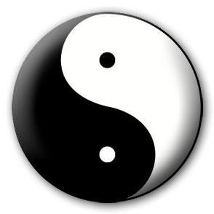
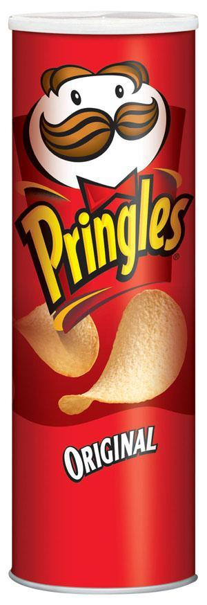


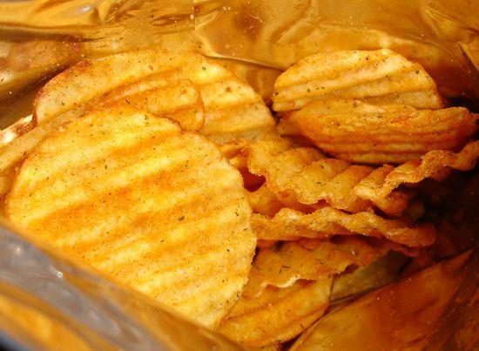
A Story of Two Collections..
List
  - A linear collection of values that stay in order
Dictionary
  - A “bag” of values, each with its own label

Slide 57
Dictionaries
tissue
calculator
perfume
money
candy
http://en.wikipedia.org/wiki/Associative_array

Slide 58
Dictionaries
Dictionaries are Python’s most powerful data collection
Dictionaries allow us to do fast database-like operations in Python
Dictionaries have different names in different languages
  - Associative Arrays - Perl / PHP
  - Properties or Map or HashMap - Java
  - Property Bag - C# / .Net

Slide 59
Dictionaries
>>> purse = dict()
>>> purse['money'] = 12
>>> purse['candy'] = 3
>>> purse['tissues'] = 75
>>> print(purse)
{'money': 12, 'tissues': 75, 'candy': 3}
>>> print(purse['candy'])
3
>>> purse['candy'] = purse['candy'] + 2
>>> print(purse)
{'money': 12, 'tissues': 75, 'candy': 5}
Lists index their entries based on the position in the list
Dictionaries are like bags - no order
So we index the things we put in the dictionary with a “lookup tag”

Slide 60
Comparing Lists and Dictionaries
Dictionaries are like lists except that they use keys instead of numbers to look up values
>>> ddd = dict()
>>> ddd['age'] = 21
>>> ddd['course'] = 182
>>> print(ddd)
{'course': 182, 'age': 21}
>>> ddd['age'] = 23
>>> print(ddd)
{'course': 182, 'age': 23}
>>> lst = list()
>>> lst.append(21)
>>> lst.append(183)
>>> print(lst)
[21, 183]
>>> lst[0] = 23
>>> print(lst)
[23, 183]

Slide 61
>>> lst = list()
>>> lst.append(21)
>>> lst.append(183)
>>> print(lst)
[21, 183]
>>> lst[0] = 23
>>> print(lst)
[23, 183]
List
Key
Value
[0]
21
lst
[1]
183
>>> ddd = dict()
>>> ddd['age'] = 21
>>> ddd['course'] = 182
>>> print(ddd)
{'course': 182, 'age': 21}
>>> ddd['age'] = 23
>>> print(ddd)
{'course': 182, 'age': 23}
Dictionary
Key
Value
['course']
182
ddd
['age']
21

Slide 62
Dictionary Literals (Constants)
Dictionary literals use curly braces and have a list of key : value pairs
You can make an empty dictionary using empty curly braces
>>> jjj = { 'chuck' : 1 , 'fred' : 42, 'jan': 100}
>>> print(jjj)
{'jan': 100, 'chuck': 1, 'fred': 42}
>>> ooo = { }
>>> print(ooo)
{}
>>>

Slide 63
Most Common Name?
marquard
cwen
cwen
zhen
zhen
marquard
csev
csev
zhen
marquard
zhen
csev
zhen

Slide 64
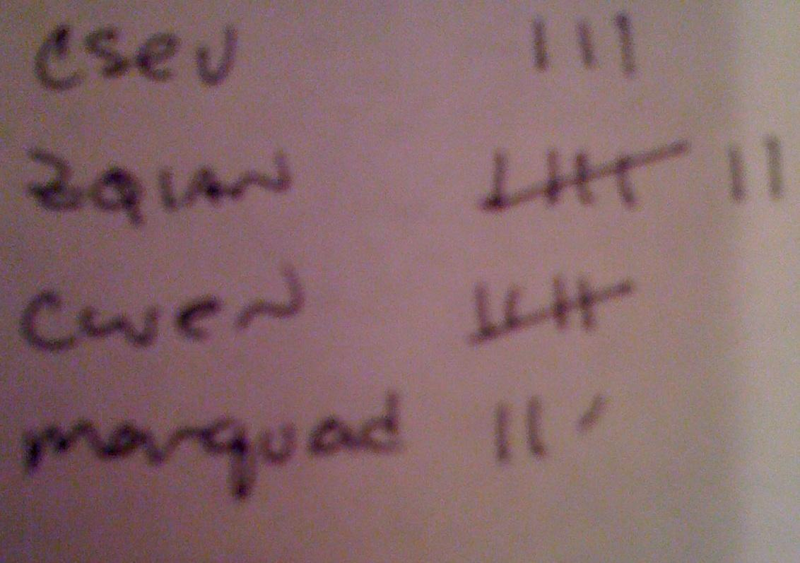
Many Counters with a Dictionary
One common use of dictionaries is counting how often we “see” something
Key
Value
>>> ccc = dict()
>>> ccc['csev'] = 1
>>> ccc['cwen'] = 1
>>> print(ccc)
{'csev': 1, 'cwen': 1}
>>> ccc['cwen'] = ccc['cwen'] + 1
>>> print(ccc)
{'csev': 1, 'cwen': 2}

Slide 65
Dictionary Tracebacks
It is an error to reference a key which is not in the dictionary
We can use the in operator to see if a key is in the dictionary
>>> ccc = dict()
>>> print(ccc['csev'])
Traceback (most recent call last):
File "<stdin>", line 1, in <module>
KeyError: 'csev'
>>> 'csev' in ccc
False

Slide 66
When We See a New Name
When we encounter a new name, we need to add a new entry in the dictionary and if this the second or later time we have seen the name, we simply add one to the count in the dictionary under that name
counts = dict()
names = ['csev', 'cwen', 'csev', 'zqian', 'cwen']
for name in names :
if name not in counts:
counts[name] = 1
else :
counts[name] = counts[name] + 1
print(counts)
{'csev': 2, 'zqian': 1, 'cwen': 2}

Slide 67
The get Method for Dictionaries
The pattern of checking to see if a key is already in a dictionary and assuming a default value if the key is not there is so common that there is a method called get() that does this for us
if name in counts:
x = counts[name]
else :
x = 0
x = counts.get(name, 0)
Default value if key does not exist (and no Traceback).
{'csev': 2, 'zqian': 1, 'cwen': 2}

Slide 68
Simplified Counting with get()
We can use get() and provide a default value of zero when the key is not yet in the dictionary - and then just add one
counts = dict()
names = ['csev', 'cwen', 'csev', 'zqian', 'cwen']
for name in names :
counts[name] = counts.get(name, 0) + 1
print(counts)
{'csev': 2, 'zqian': 1, 'cwen': 2}
Default

Slide 69
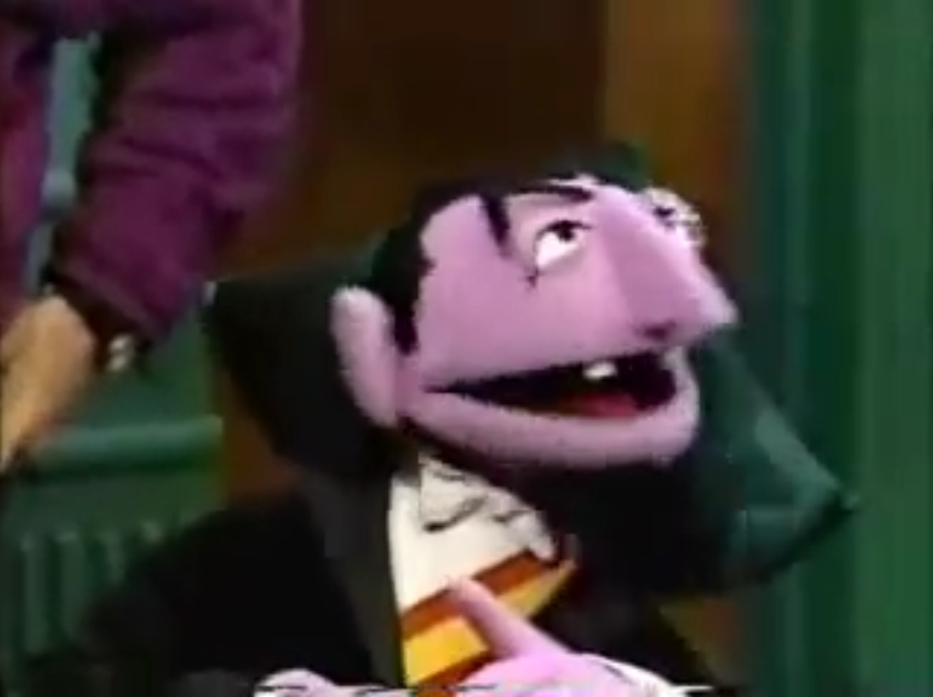
Simplified Counting with get()
counts = dict()
names = ['csev', 'cwen', 'csev', 'zqian', 'cwen']
for name in names :
counts[name] = counts.get(name, 0) + 1
print(counts)
http://www.youtube.com/watch?v=EHJ9uYx5L58

Slide 70
Counting Words in Text

Slide 71
Writing programs (or programming) is a very creative and rewarding activity. You can write programs for many reasons ranging from making your living to solving a difficult data analysis problem to having fun to helping someone else solve a problem. This book assumes that everyone needs to know how to program and that once you know how to program, you will figure out what you want to do with your newfound skills.
We are surrounded in our daily lives with computers ranging from laptops to cell phones. We can think of these computers as our “personal assistants” who can take care of many things on our behalf. The hardware in our current-day computers is essentially built to continuously ask us the question, “What would you like me to do next?”
Our computers are fast and have vast amounts of memory and could be very helpful to us if we only knew the language to speak to explain to the computer what we would like it to do next. If we knew this language we could tell the computer to do tasks on our behalf that were repetitive. Interestingly, the kinds of things computers can do best are often the kinds of things that we humans find boring and mind-numbing.

Slide 72
Counting Pattern
counts = dict()
print('Enter a line of text:')
line = input('')
words = line.split()
print('Words:', words)
print('Counting...')
for word in words:
counts[word] = counts.get(word,0) + 1
print('Counts', counts)
The general pattern to count the words in a line of text is to split the line into words, then loop through the words and use a dictionary to track the count of each word independently.

Slide 73
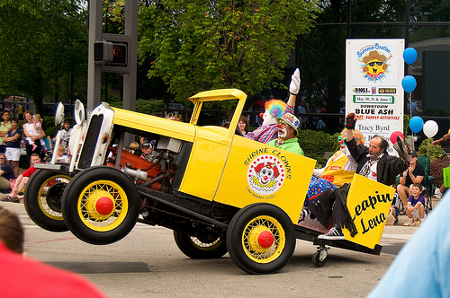
python wordcount.py
Enter a line of text:
the clown ran after the car and the car ran into the tent and the tent fell down on the clown and the car
Words: ['the', 'clown', 'ran', 'after', 'the', 'car', 'and', 'the', 'car', 'ran', 'into', 'the', 'tent', 'and', 'the', 'tent', 'fell', 'down', 'on', 'the', 'clown', 'and', 'the', 'car']
Counting…
Counts {'and': 3, 'on': 1, 'ran': 2, 'car': 3, 'into': 1, 'after': 1, 'clown': 2, 'down': 1, 'fell': 1, 'the': 7, 'tent': 2}
http://www.flickr.com/photos/71502646@N00/2526007974/

Slide 74
python wordcount.py
Enter a line of text:
the clown ran after the car and the car ran into the tent and the tent fell down on the clown and the car
Words: ['the', 'clown', 'ran', 'after', 'the', 'car', 'and', 'the', 'car', 'ran', 'into', 'the', 'tent', 'and', 'the', 'tent', 'fell', 'down', 'on', 'the', 'clown', 'and', 'the', 'car']
Counting...
Counts {'and': 3, 'on': 1, 'ran': 2, 'car': 3, 'into': 1, 'after': 1, 'clown': 2, 'down': 1, 'fell': 1, 'the': 7, 'tent': 2}
counts = dict()
line = input('Enter a line of text:')
words = line.split()
print('Words:', words)
print('Counting...’)
for word in words:
counts[word] = counts.get(word,0) + 1
print('Counts', counts)

Slide 75
Definite Loops and Dictionaries
Even though dictionaries are not stored in order, we can write a for loop that goes through all the entries in a dictionary - actually it goes through all of the keys in the dictionary and looks up the values
>>> counts = { 'chuck' : 1 , 'fred' : 42, 'jan': 100}
>>> for key in counts:
... print(key, counts[key])
...
jan 100
chuck 1
fred 42
>>>

Slide 76
Retrieving Lists of Keys and Values
>>> jjj = { 'chuck' : 1 , 'fred' : 42, 'jan': 100}
>>> print(list(jjj))
['jan', 'chuck', 'fred']
>>> print(list(jjj.keys()))
['jan', 'chuck', 'fred']
>>> print(list(jjj.values()))
[100, 1, 42]
>>> print(list(jjj.items()))
[('jan', 100), ('chuck', 1), ('fred', 42)]
>>>
You can get a list of keys, values, or items (both) from a dictionary
What is a “tuple”? - coming soon...

Slide 77
Bonus: Two Iteration Variables!
We loop through the key-value pairs in a dictionary using *two* iteration variables
Each iteration, the first variable is the key and the second variable is the corresponding value for the key
jjj = { 'chuck' : 1 , 'fred' : 42, 'jan': 100}
for aaa,bbb in jjj.items() :
print(aaa, bbb)
jan 100
chuck 1
fred 42
aaa
bbb
[jan]
100
[chuck]
1
[fred]
42

Slide 78
name = input('Enter file:')
handle = open(name)
counts = dict()
for line in handle:
words = line.split()
for word in words:
counts[word] = counts.get(word,0) + 1
bigcount = None
bigword = None
for word,count in counts.items():
if bigcount is None or count > bigcount:
bigword = word
bigcount = count
print(bigword, bigcount)
python words.py
Enter file: words.txt
to 16
python words.py
Enter file: clown.txt
the 7
Using two nested loops

Slide 79
PYTHON – DATA TYPES - TUPLE

Slide 80
Tuples Are Like Lists
Tuples are another kind of sequence that functions much like a list - they have elements which are indexed starting at 0
>>> x = ('Glenn', 'Sally', 'Joseph')
>>> print(x[2])
Joseph
>>> y = ( 1, 9, 2 )
>>> print(y)
(1, 9, 2)
>>> print(max(y))
9
>>> for iter in y:
... print(iter)
...
1
9
2
>>>

Slide 81
but... Tuples are “immutable”
Unlike a list, once you create a tuple, you cannot alter its contents - similar to a string
>>> x = [9, 8, 7]
>>> x[2] = 6
>>> print(x)
>>>[9, 8, 6]
>>>
>>> y = 'ABC'
>>> y[2] = 'D'
Traceback:'str' object does
not support item
Assignment
>>>
>>> z = (5, 4, 3)
>>> z[2] = 0
Traceback:'tuple' object does
not support item
Assignment
>>>

Slide 82
Things not to do With Tuples
>>> x = (3, 2, 1)
>>> x.sort()
Traceback:
AttributeError: 'tuple' object has no attribute 'sort'
>>> x.append(5)
Traceback:
AttributeError: 'tuple' object has no attribute 'append'
>>> x.reverse()
Traceback:
AttributeError: 'tuple' object has no attribute 'reverse'
>>>

Slide 83
A Tale of Two Sequences
>>> l = list()
>>> dir(l)
['append', 'count', 'extend', 'index', 'insert', 'pop', 'remove', 'reverse', 'sort']
>>> t = tuple()
>>> dir(t)
['count', 'index']

Slide 84
Tuples are More Efficient
Since Python does not have to build tuple structures to be modifiable, they are simpler and more efficient in terms of memory use and performance than lists
So in our program when we are making “temporary variables” we prefer tuples over lists

Slide 85
Tuples and Assignment
We can also put a tuple on the left-hand side of an assignment statement
We can even omit the parentheses
>>> (x, y) = (4, 'fred')
>>> print(y)
fred
>>> (a, b) = (99, 98)
>>> print(a)
99

Slide 86
Tuples and Dictionaries
>>> d = dict()
>>> d['csev'] = 2
>>> d['cwen'] = 4
>>> for (k,v) in d.items():
... print(k, v)
...
csev 2
cwen 4
>>> tups = d.items()
>>> print(tups)
dict_items([('csev', 2), ('cwen', 4)])
The items() method in dictionaries returns a list of (key, value) tuples

Slide 87
Tuples are Comparable
The comparison operators work with tuples and other sequences. If the first item is equal, Python goes on to the next element, and so on, until it finds elements that differ.
lexicographical comparison
>>> (0, 1, 2) < (5, 1, 2)
True
>>> (0, 1, 2000000) < (0, 3, 4)
True
>>> ( 'Jones', 'Sally' ) < ('Jones', 'Sam')
True
>>> ( 'Jones', 'Sally') > ('Adams', 'Sam')
True

Slide 88
Using sorted()
>>> d = {'a':10, 'b':1, 'c':22}
>>> t = sorted(d.items())
>>> t
[('a', 10), ('b', 1), ('c', 22)]
>>> for k, v in sorted(d.items()):
... print(k, v)
...
a 10
b 1
c 22
We can do this even more directly using the built-in function sorted that takes a sequence as a parameter and returns a sorted sequence

Slide 89
Sort by Values Instead of Key
If we could construct a list of tuples of the form (value, key) we could sort by value
We do this with a for loop that creates a list of tuples
  >>> c = {'a':10, 'b':1, 'c':22}
  >>> tmp = list()
  >>> for k, v in c.items() :
  ... tmp.append( (v, k) )
  ...
  >>> print(tmp)
  [(10, 'a'), (22, 'c'), (1, 'b')]
  >>> tmp = sorted(tmp, reverse=True)
  >>> print(tmp)
  [(22, 'c'), (10, 'a'), (1, 'b')]

Slide 90
The top 10 most common words
fhand = open('romeo.txt')
counts = {}
for line in fhand:
words = line.split()
for word in words:
counts[word] = counts.get(word, 0 ) + 1
lst = []
for key, val in counts.items():
newtup = (val, key)
lst.append(newtup)
lst = sorted(lst, reverse=True)
for val, key in lst[:10] :
print(key, val)

Slide 91
Even Shorter Version
>>> c = {'a':10, 'b':1, 'c':22}
>>> print( sorted( [ (v,k) for k,v in c.items() ] ) )
[(1, 'b'), (10, 'a'), (22, 'c')]
List comprehension creates a dynamic list. In this case, we make a list of reversed tuples and then sort it.
http://wiki.python.org/moin/HowTo/Sorting

